Slide 1
VIRTUAL
OPEN HOUSE
ON
STATISTICS
GRADUATE
PROGRAMS
Nov. 28, 2023

Slide 2
Program for Open House
.
Speaker | Topic
Dr. TN Sriram; Dept. Head | Introduction to Statistics Department
Dr. Jaxk Reeves, Grad Coord-I | Statistics Graduate Programs
Dr. Dan Hall; SCC Director | UGA Statistical Consulting Center
Graduate Student Panel | Graduate Student Experiences/ Q&A
Dr. Liang Liu; Grad Coord-II | How to Apply, Deadlines & Support

Slide 3
AREAS THAT NEED STATISTICS
Physical Science
Astronomy, Chemistry, Physics
Health and Medicine
Biology, Genetics, Clinical Trials, Epidemiology, Pharmacology
Social Science
Education, Psychology, Anthropology
Government
Census, Law, National Defense
Business and Economics
Marketing, Financial Analysis
Environment
Agriculture, Ecology, Forestry, Animal Population

Slide 4
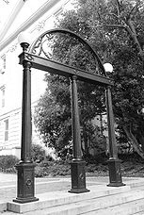
UNIVERSITY OF GEORGIA
Founded in 1785, first public univ. in the US
The Graduate School Enrollment in Fall 2023: 10,014 students
Total Fall 2023 Enrollment 42,540
UGA is ranked 47th in national university and 15th in public school rankings (U.S. News & World Report’s 2022)

Slide 5
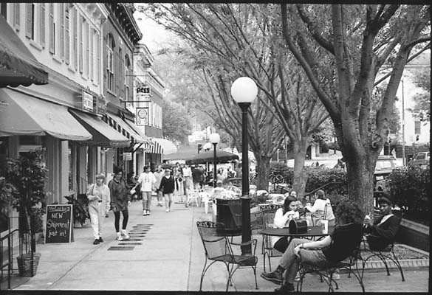
ATHENS, GEORGIA
Centrally located in Georgia and only 1 hour away from Atlanta
Plenty of Activities
Professional Development
Indoor
Outdoor
Family
Downtown
Campus
Athens:
http://onlineathens.com/
http://www.redandblack.com/
http://www.ajc.com/
www.flagpole.com

Slide 6
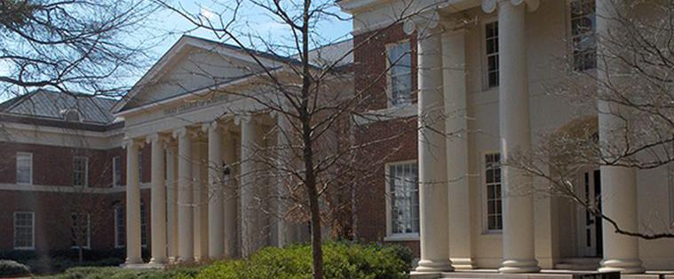
UGA STATISTICS DEPARTMENT
Was originally formed in 1964 as Dept of Statistics and Computer Science
In 1984, became Dept of Statistics
31 Current Faculty Members
9 Professors, 8 Assoc. Professors, 3 Assist. Professors, 11 Non-tenure track faculty
2 Staff Members
Graduate Students
Around 25 MS, 30 Secondary MS, 40 PhD

Slide 7
Graduate Student Demographics Fall 2023
Degree Program | Number of students |  | Number Male | Number Female |  | From USA | From China | From Rest of the World
MS | 22 |  | 9 | 13 |  | 15 | 5 | 2
MS-2 | 32 |  | 14 | 18 |  | 5 | 16 | 11
PhD | 39 |  | 22 | 17 |  | 6 | 24 | 9
Total | 93 |  | 45 | 48 |  | 26 | 45 | 22

Slide 8
MASTER’S PROGRAM In Statistics
5 required + 6 elective 3-hour courses; maintain GPA of 3.00 or higher
Core requirements (5 Courses)
Linear Models: STAT 6420-6430
Mathematical Statistics: STAT 6510-6520
Consulting: STAT 8000
Elective requirements (6 Courses)
Non-thesis option: Choose 6 electives and pass Qualifying Exam (85%)
Thesis option: Choose 4 electives, 2 STAT 7300, write a thesis (15%)
Qualifying exam: Offered in early August and early January
Two-day take-home data analysis exam
Program typically requires one and one-half to two years of study

Slide 9
Dual-Degree MS PROGRAM (MS-2)
Same requirements as MS degree
Typically earned by PhD students in other scientific fields
Program typically requires about 2-3 years of study
Very popular with international students
Application process for entry is easier (and cheaper) because applicants are already at UGA

Slide 10
PhD PROGRAM
Maintain GPA of 3.00 or higher in 9 required + 6 elective courses
Core requirements
1st-year Linear Models: STAT 6420-6430 and STAT 8260
1st-year Mathematical Statistics: STAT 6810-6820
Second-Year core: Probability Theory, Advanced Inference, Statistical Computing, Bayesian Analysis
Qualifying exams: Offered once per year in early August
Theory: one-day open book exam
Data Analysis: four-day take-home data analysis
Comprehensive exams: third-year
Advisory committee
Written and Oral
Dissertation proposal: fourth-year
Dissertation defense: fifth-year
Typical program requires 5 years (4 if entering with M.S.)

Slide 11
Placements of Recent Graduates
PhD: Arizona State U.; Boston U; College of Charleston; UGA; Indiana U; Drake U, Duke U; Clemson U; SMU; U. Alabama; NC A&T; U. Oregon; U. Virginia; Virginia Commonwealth; William & Mary;
State Farm; Wells Fargo; Facebook; Workday; Sprint; Johnson & Johnson; Capital One; ING Direct; City Bank; Lexis-Nexis; Liberty Mutual; JP Morgan Chase; Synovus, Apple; FDA
2023: 8 PhD Graduates (2 Prof; 2 Post-doc, 4 statistician)
2022: 11 PhD Graduates (1 Prof; 2 Post-doc, 8 statistician)
2021: 11 PhD Graduates (1 Prof; 5 Post-doc, 5 statistician)
2020: 7 PhD Graduates (4 Prof; 2 Post-doc, 1 statistician)
2019: 6 PhD Graduates (4 Prof; 0 Post-doc, 2 statistician)
More at https://www.stat.uga.edu/phd-alumni-and-job-placements
MS & MS-2: Apple; Assurant, Atlanta; Coca-Cola; Sun Trust; Munich Reinsurance; Lexis-Nexis; Black Arch, DC; Centers for Disease Control and Prevention; Ernst & Young, NYC; James Madison University; Merial, Atlanta; State Farm, Atlanta; U Virginia; US Department of Agriculture, St. Louis; and more.

Slide 12
Statistical Consulting Center
.
Presentation by Professor Dan Hall; SCC Director

Slide 13
Graduate Student Panel
.
Name | Status
Sherwin Shirazi | 1st-year MS Student
Joy Bick | 2nd-year MS Student
Jie Jason Lian | 3rd-year Dual-degree MS Student
Ivy Collins | 1st-year PhD Student
Greg Ellison | 4rd-year PhD Student
ShiYuan Deng | 5th-year PhD Student

Slide 14
APPLICATION DEADLINES
For applicants seeking financial support:
January 1 (Fall semester)
Other deadlines ->
Other documents
Three letters of recommendation
Transcript(s)
SOP and Resume (CV)
Official IELTS scores (if applicable to international students)
GRE is required
http://www.grad.uga.edu
Not Seeking Support:
Domestic Applicants
Fall--------------------July 1
Spring ---------------November 15
International Applicants
Fall-------------------April 15
Spring --------------October 15

Slide 15
ADMISSION REQUIREMENTS
Minimal Departmental requirements
* GRE (We care mostly about GRE-Q)
At least 2 courses in Statistics
At least some background in Computing/Software
Three semesters of Calculus
One Course in Linear algebra
Departmental evaluations
Performance in mathematical and statistical coursework (most imp.)
Recommendation letters
Other documents
Statement of purpose
Resume (CV)
Any Interesting Work/Research/Teaching Experience

Slide 16
ACCEPTANCE DECISIONS
Two-fold process (Most decisions for Fall are posted in February)
(1) Department
Academic department faculty review file
Department submits recommendation to accept or refuse applicant to Graduate School
(2) Graduate School (GS)
GS reviews files of applicants recommended for acceptance
If GS agrees with department decision, applicant is admitted
Applicant receives official acceptance letter from Grad School

Slide 17
FUNDING OPPORTUNITIES
Typically, 9-12(PhD) and 5-7(MS) new supported admissions per year
Types of Financial Support (# Currently Holding)
Graduate School Master’s Award and Doctoral Award (1)
Research Assistantship (14)
Internship (2)
Teaching Assistantship (29)
Consulting Assistantship (5)
Graduate School Assistantship (1)
MAGNet Program sponsored by State Farm (4)
Graduate Out-of-State Tuition Waivers (1)
Regent’s Out-of-State Tuition Waivers (1)
Notes:
State Farm wants to start a MAGNet program in the southeast similar to one that they have at UIUC (see http://en.wikipedia.org/wiki/State_Farm_Research_Center), and they have chosen our department to do so. As a start, they will select 3 or 4 MS students from those that we recruit (US citizens or permanent residents) and will provide a 1-year assistantship for these students to work on State Farm projects here in Athens for 18 or 20 hours per week. They would like students to start as interns in the summer before they start their program of study. After this year, students have no obligation to continue. If State Farm likes them and they decide to continue, then they will have to commit to work for State Farm for 2 (?) years after graduation. State farm is to rent some space in Athens where these students would be supervised.

Slide 18
MAGNet INtern PROGRAM (STATE FARM)
Open to MS students only
Must be a US citizen or permanent resident
About 4 new students selected each year
Interviews on site or by phone
Summer internship plus 1-year (or 2-year) assistantship
20 hours per week
Supervised by State Farm
Opportunity to be hired by State Farm upon graduation with MS
Notes:
State Farm wants to start a MAGNet program in the southeast similar to one that they have at UIUC (see http://en.wikipedia.org/wiki/State_Farm_Research_Center), and they have chosen our department to do so. As a start, they will select 3 or 4 new MS students from those that we recruit (US citizens or permanent residents) and will provide a 1-year assistantship for these students to work on State Farm projects here in Athens for 18 or 20 hours per week. They would like students to start as interns in the summer before they start their program of study. After this year, students have no obligation to continue. If State Farm likes them and they decide to continue, then they will have to commit to work for State Farm for 2 (?) years after graduation. State farm is to rent some space in Athens where these students would be supervised.

Slide 19
CONTACTS
Much information available at www.stat.uga.edu
If you have any questions, feel free to email the Graduate Coordinator for Admissions: Dr. Jaxk Reeves, jaxk@uga.edu

